Slide 1

LIGHT: Blackbody Radiation and spectra

Slide 2
Key Objectives
Description of blackbody radiation.
Atoms of an element emit and absorb specific wavelengths of light that are unique to that element; this is the basis of spectral analysis

Slide 3
Blackbody radiation
All objects above absolute zero emit energy in the form electromagnetic radiation.
A blackbody is a theoretical opaque object that absorbs all radiation at all wavelengths, reflecting and transmitting none.
As the blackbody absorbs the radiation it absorbs energy. The particles in the blackbody will vibrate in response to this energy gain, these vibrating charges creates electromagnetic radiation. It can emits EM radiation at all wavelengths.
Therefore a blackbody is a theoretical object which is both and perfect absorber and perfect emitter of electromagnetic radiation over all wavelengths.
At room temperature any such object would appear perfectly black.

Slide 4
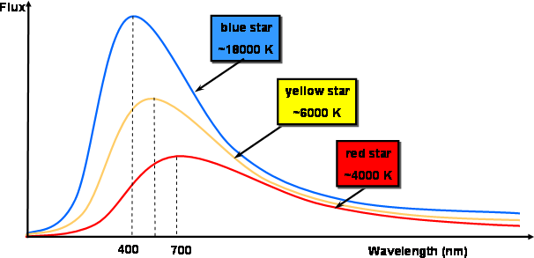
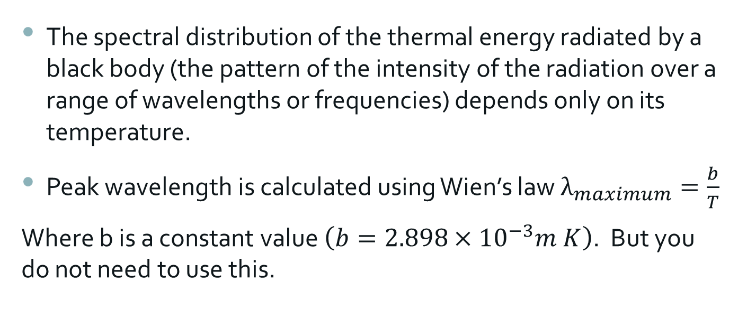
The spectral distribution of the thermal energy radiated by a black body (the pattern of the intensity of the radiation over a range of wavelengths or frequencies) depends only on its temperature.
Peak wavelength is calculated using Wien’s law $λ_{maximum}=\frac{b}{T}$
Where b is a constant value $\left(b=2.898×{10}^{−3}m K\right)$. But you do not need to use this.

Slide 5
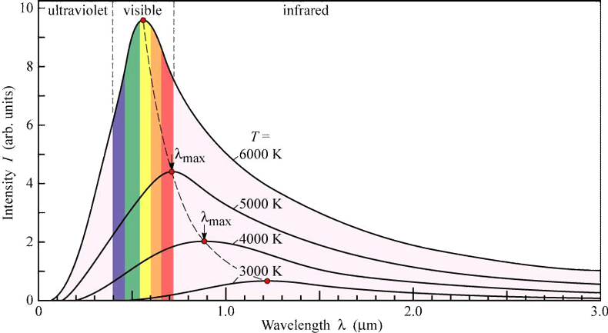
http://astro.unl.edu/naap/blackbody/animations/blackbody.swf

Slide 6
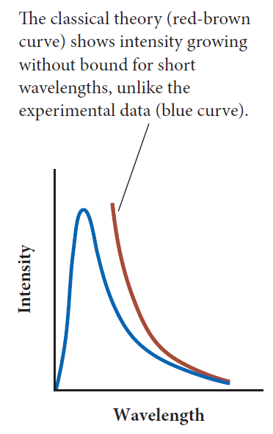
Ultraviolet catastrophe
Wien’s law works, but the observed spectrum cannot be explained using classical physics.
A blackbody should set up modes of vibration at all energies, the high energy modes being favoured (more short wavelengths emitted – hence the ultraviolet reference).
Therefore as temperature rises, more and more high energy modes would be emitted.
Instead of a peak energy followed by a decline (which is what we observe), there would be no limit to high energy emission.

Slide 7
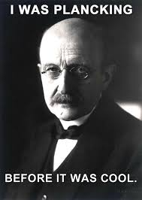
How do we reconcile the difference between classical predictions and observations? Thank Planck.
Plank suggested that electromagnetic radiation was not a continuous wave, that there were only discrete modes of vibrations for oscillators.
This meant that not all modes were equally able to be produced. Emission and absorption occurred in discrete quanta.
Planck created a constant value known as Planck’s constant (h) and determined that energy must relate to frequency by the equation E=hf. This takes it away from a continuous spectrum to discrete packets of energy. This matched experimental results.
Planck had described a property of EM radiation that was not described by its wave nature. This was later used by Einstein to establish that all EM radiation are discrete packets of energy (using the photoelectric effect).

Slide 8
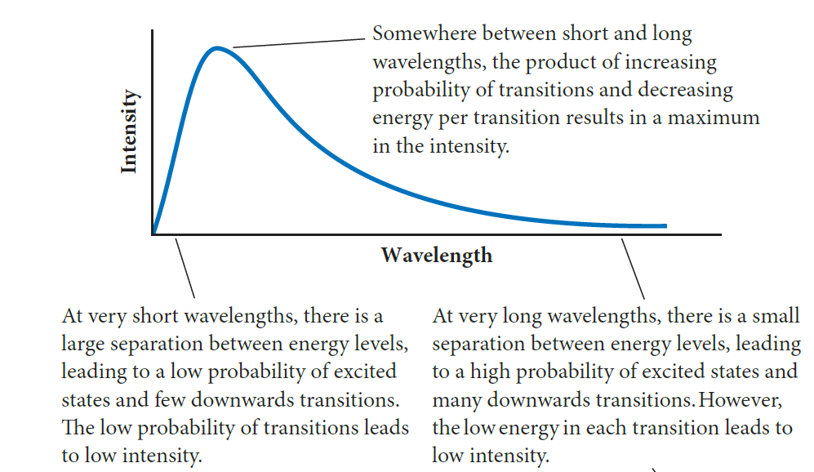

Slide 9



In a continuous spectrum all colours can be seen
In a discrete spectrum particular colours are evident:
  Emission spectrum – heated gas produces bright parallel lines
  Absorption spectrum – white light through a cold gas produces dark bands in a continuous spectrum.
Notes:
Light from different sources can be dispersed into its component colours. The spectrum can be continuous, where there is a gradual change through the colours of the rainbow, or discrete, where particular lines can be seen. In an emission spectrum, the discrete lines can be seen as bright colours. In an absorption spectrum the colours are missing from a background continuous spectrum.

Slide 10
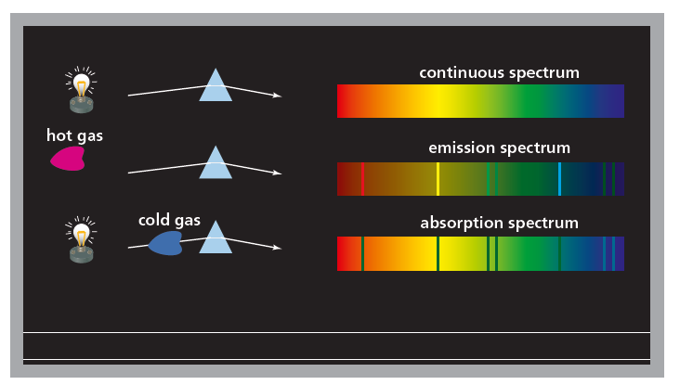
A source of white light produces all the colours of the rainbow, with gradual change from red at one end to blue at the other. This is a continuous spectrum.
Emission spectra come from a heated source. The energy causes the emissions from the atom.
Absorption spectra come from the passage of energetic light through a cold gas.

Slide 11
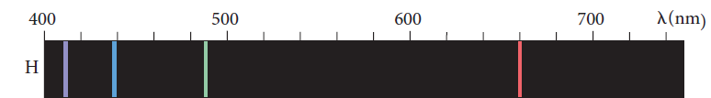
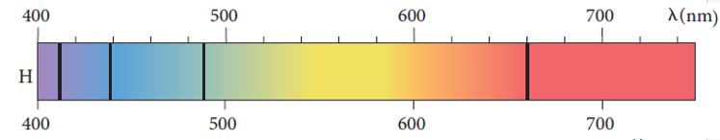
The hydrogen absorption spectrum has dark lines in a continuous background spectrum.
When hydrogen emission and absorption spectra are compared, bright emission lines are at the same positions as the absorption lines.
Hydrogen emission spectrum
Hydrogen absorption spectrum

Slide 12
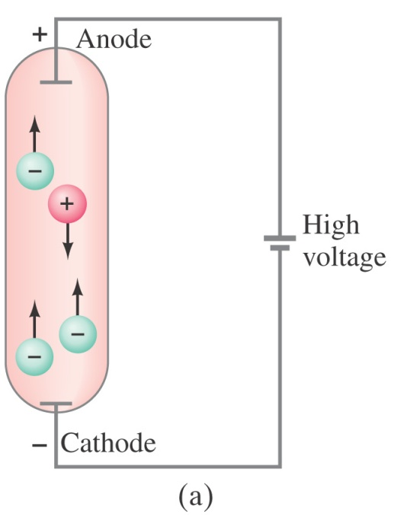
Emission Spectra
Some methods for producing light produce only certain frequencies of visible light as opposed to a continuous spectrum.
A gas in a discharge tube (essentially a vacuum tube) with an applied EMF source will ionise in the tube. The gas within this tube will glow with light.
The light produced from this will be produced at frequencies characteristic of the chemical composition of the gas producing the light.
When the light is passed through a prism it is dispersed into the individual characteristic frequencies.

Slide 13
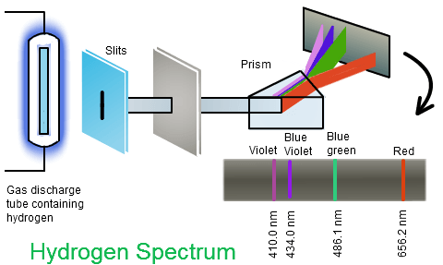
What is visible in the gas tube is a purple light, this light does not include the entire visible EM spectrum.

Slide 14
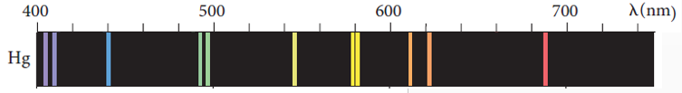
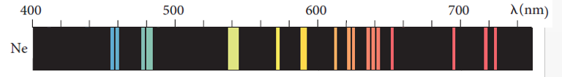
Mercury emission spectrum
Neon emission spectrum
Notes:
For a polyatomic gas instead of line spectra we get band spectra (thicker than the individual lines).

Slide 15
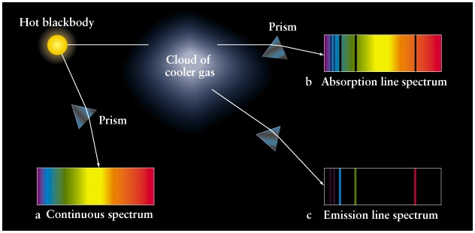
Absorption spectra
When light that has a continuous spectra is shone through a substance (such as hydrogen gas), then the substance will absorb frequencies characteristic of the substance.
The dispersion pattern will have black lines where the absorbed frequencies occur.

Slide 16
